Slide 1

Project Name : KEY LOGGER AND SECURITY - Understanding the Threat and to protect against it .
Student Name : MAHESH BABU BASWANI

Slide 2

KEY LOGGER AND SECURITY

Slide 3


AGENDA
In legitimate contexts, keyloggers may be used by employers to monitor employee activities on company-owned devices to ensure productivity and compliance with company policies.
Keyloggers are sometimes used for surveillance purposes, either by law enforcement agencies conducting investigations or by individuals seeking to monitor others without their knowledge or consent.
In forensic investigations, keyloggers may be used to gather evidence of unauthorized activities or to reconstruct actions taken on a compromised system.
Ethical hackers and security professionals may use keyloggers to test the security of systems and identify vulnerabilities that could be exploited by malicious actors.

Slide 4


PROJECT OVERVIEW
A project overview of a keylogger involves outlining its purpose and objectives clearly. For instance, if it's aimed at monitoring employee activities for security purposes within a company, the keylogger would focus on capturing keystrokes and possibly screenshots discreetly.
Data security is paramount, so encryption and secure storage methods are implemented to protect sensitive information like passwords.
Ethical considerations such as obtaining consent and ensuring compliance with privacy laws are crucial aspects addressed in the project. Testing and validation procedures are also conducted to ensure the keylogger functions effectively without compromising system performance or user privacy.
Throughout the project, documentation is maintained, and ethical reviews are considered to ensure the project aligns with responsible use practices.

Slide 5


PROBLEM STATEMENT
1.The keyloggers can be detected using antiviruses. Installation of hardware keyloggers is difficult without the knowledge of the owner of the system.
2.The expectation of privacy and can lead to identity theft, financial loss, or personal embarrassment if the captured information falls into the wrong hands.
3.If a keylogger is installed on a device, it can capture all keystrokes, bypassing encryption and other security measures intended to protect data.
4.This can result in slower operation of the device, which may be noticeable to users and impact productivity or usability.

Slide 6

THE END USERS:
1.Legitimate users :
Parents : Monitoring their children’s online activities for safety.
Employers : Overseeing employees’ use of company computers to ensure
productivity and security.
Law Enforcement: Investigating criminal activities with proper legal authorization.
Individuals : Personal use for data backup or tracking one’s own device usage.
2.Illegitimate Users :
Cybercriminals : Deploying keyloggers to steal sensitive information like passwords
and credit card details.
Hackers : Using keyloggers as a tool for unauthorized access to
personal or corporate systems.

Slide 7

SOLUTION AND ITS VALUE PROPOSITION
Keyloggers are tools that record every keystroke you make on your device, often used by cybercriminals to steal sensitive information like passwords and credit card numbers.
Use Antivirus Software: Ensure you have a reliable antivirus program that can detect and remove keyloggers. Regularly update your antivirus .
Enable Firewalls: A good firewall can block unauthorized access to your network and devices, providing an additional layer of security.
Use a VPN: A Virtual Private Network (VPN) encrypts your internet connection, making it harder for keyloggers to intercept your data.

Slide 8

THE WOW IN SOLUTION
1.Regular Scans and Updates: Perform regular system scans and keep your operating system and all software up-to-date to patch any security vulnerabilities.
2.Be Cautious with Downloads: Avoid downloading software or opening email attachments from unknown sources, as these can be vectors for keylogger installation.
3.Two-Factor Authentication (2FA): Enable 2FA on your accounts to add an extra layer of security. Even if a keylogger captures your password, it won't be enough to access your accounts.
4. Use Complex Passwords: Create strong, unique passwords for each of your accounts to reduce the risk of multiple accounts being compromised.
Implementing these measures can significantly reduce the risk of keylogger attacks and enhance your overall cybersecurity.
8

Slide 9
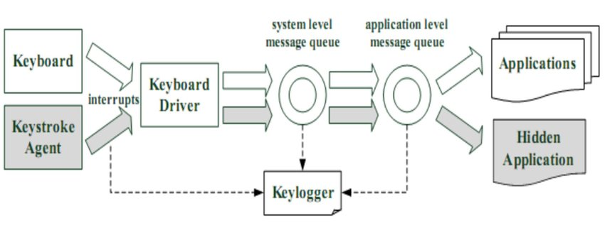
MODELLING
Teams cam add wireframes
Design Phase Consideration: During the initial design phase of developing key logger software, teams might create wireframes to outline the user interface (UI) and user experience (UX) of the software.
User Interface Design: Teams could add wireframes to plan out the various screens, functionalities, and interactions of the key logger software. Wireframes act as a blueprint.
Collaborative Development: "Teams can add wireframes" could imply that different team members or stakeholders collaborate by contributing ideas and feedback using wireframes. This collaborative approach ensures that the key logger software meets functional and usability requirements.
Integration of Design and Functionality: Wireframes can serve as a bridge between the design and functionality of the key logger. They help in aligning the visual aspects of the software with its core functionality.
9

Slide 10
ADVANTAGES & DISADVANTAGES
Advantages:
Monitoring and Surveillance
Parental Control
Password Recovery
Law Enforcement
Debugging
Disadvantages:
Privacy Concerns
Malware Threat
Legal Issues
False Sense of Security
Detection and Removal Challenges
ALGORITHMS
Form Grabbing
Memory Injection
Keyboard Hooks
API Hooking
Network-based Keylogging

Slide 11

RESULTS
Monitoring and Accountability: Key loggers are often used by employers to monitor employee activities on company devices.
Detecting Unauthorized Access: In personal or corporate environments, key loggers can be used to detect unauthorized access attempts.
Forensic Analysis: In forensic investigations, key loggers can be valuable tools for capturing evidence related to unauthorized activities, cybercrime, or insider threats.
Security Auditing: Key loggers can aid in security audits by providing insights into how users interact with systems and whether there are any anomalies or risky behaviors that could indicate security vulnerabilities or policy violations.
11

Slide 12

Output:

Slide 13
Git Link
https://github.com/MAHESHBABU996/MaheshB-KeyLogger.git

